Slide 1
SRI SANKARA’S DEGREE COLLEGE,KURNOOL RAYALASEEMA UNIVERSITY R.Somanath

Slide 2
Social engineering and phshing attcks
Case study analysis

Slide 3
Case study anaylsis
Social engineering is an attack vector that relies heavily on human interaction and often involves manipulating people into breaking normal security procedures and best practices to gain unauthorized access to systems, networks or physical locations or for financial gain.
Threat actors use social engineering techniques to conceal their true identities and motives, presenting themselves as trusted individuals or information sources.
The objective is to influence, manipulate or trick users into releasing sensitive information or access within an organization. Many social engineering exploits rely on people's willingness to be helpful or fear of punishment. For example, the attacker might pretend to be a co-worker who has some kind of urgent problem that requires access to additional network resources.
Social engineering is a popular tactic among attackers because it is often easier to exploit people than it is to find a network or software vulnerability.
Hackers will often use social engineering tactics as a first step in a larger campaign to infiltrate a system or network and steal sensitive data or disperse malware

Slide 4
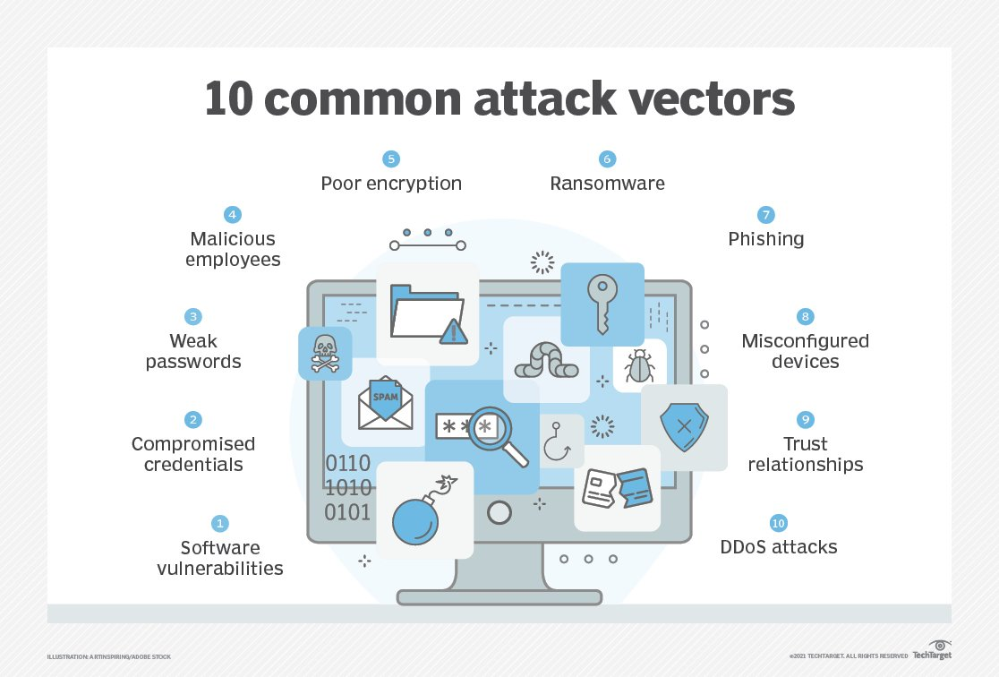
Social engineering 10 types common attack

Slide 5
Consequences of cyber attcks finanical loss and customer trust
Absolutely, discussing the consequences of a cyberattack on an organization's reputation, financial losses, and customer trust is crucial, as these aspects are often the most significant and long-lasting impacts of such incidents.
Reputation Damage: A cyberattack can inflict severe damage to an organization's reputation. The public perception of the organization may shift from one of trust and reliability to skepticism and distrust. This can be particularly damaging for businesses that handle sensitive customer data, as customers may question the organization's ability to safeguard their information. Moreover, negative media coverage and public scrutiny can further tarnish the organization's image, making it challenging to regain trust and credibility in the eyes of customers, partners, and stakeholders.
Financial Losses: The financial implications of a cyberattack can be staggering. Beyond the immediate costs associated with mitigating the attack, such as incident response, forensic investigations, and system repairs, there are often indirect financial losses that can be even more significant. These may include loss of revenue due to downtime or disrupted operations, regulatory fines and legal fees, increased insurance premiums, and decreased market value of the organization's stock. Furthermore, the long-term impact on profitability can be substantial if customers choose to take their business elsewhere due to concerns about security and reliability.
Customer Trust: Perhaps one of the most critical consequences of a cyberattack is the erosion of customer trust. When customers entrust their sensitive information to an organization, they expect it to be handled with care and confidentiality

Slide 6
Role-play Exercise and social engineering examples
In no particular order, here are nine common cyber threats that leverage social engineering tactics to gain access to sensitive information. While most of these attacks occur online, several can rear their heads in physical spaces like offices, apartment buildings, and cafes.
1. Phishing :
The most pervasive way of implementing social engineering, hackers will use deceptive emails, websites, and text messages to steal sensitive personal or organizational information from unsuspecting victims.
Despite how well-known phishing email techniques are, 1 in 5 employees still click on those suspicious links
2. Spear Phishing :
This email scam is used to carry out targeted attacks against individuals or businesses. Spear phishing is more intricate than your average mass phishing email, as it requires in-depth research on potential targets and their organizations
3. Baiting :
This type of attack can be perpetrated online or in a physical environment. The cyber criminal usually promises the victim a reward in return for sensitive information or knowledge of its whereabouts.
4. Malware :
A category of attacks that includes ransomware, victims are sent an urgently worded message and tricked into installing malware on their device(s).
Ironically, a popular tactic is telling the victim that malware has already been installed on their computer and that the sender will remove the software if they pay a fee.
5. Pretexting :
This attack involves the perpetrator assuming a false identity to trick victims into giving up information. Pretexting is often leveraged against organizations with an abundance of client data, like banks, credit card providers, and utility companies.

Slide 7
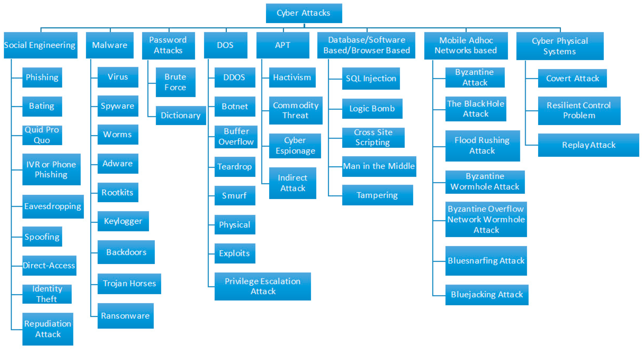
Cyber attacks for hancking tools for maitaince for them

Slide 8
Email phshning attack and analysis
A phishing email is a cyber attack that relies on deception to steal confidential information from users and organizations.
Phishing victims are tricked into disclosing information that should be kept private. When a phishing email arrives, recipients have no reason to doubt the request.
They believe that the party requesting the information – often posing as a familiar platform, a trusted vendor, colleague, or boss – is who they say they are. With the best intentions, phishing email victims respond without a second thought. In phishing emails, cyber criminals often ask for the following information:
Date of birth
Social security number
Phone number
Home address
Credit card details
Login details
Password (or other information needed to reset your password)
Cyber criminals then use this information to impersonate you and apply for credit cards or loans, open bank accounts, and commit other fraudulent acts.
Some cyber criminals use the information collected in an initial phishing email to launch more targeted cyber attacks, such as spear phishing or business email compromises (BEC), that rely on

Slide 9
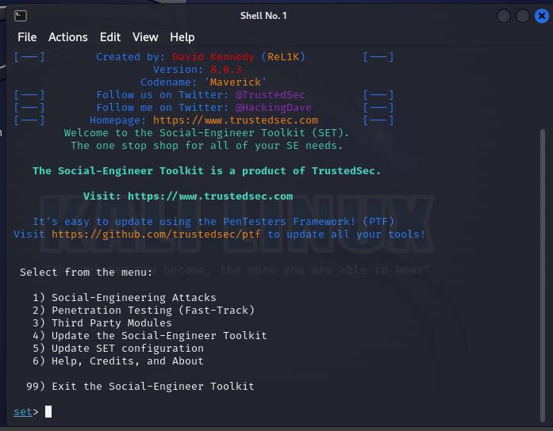
Social tool kit and server phshing attack

Slide 10
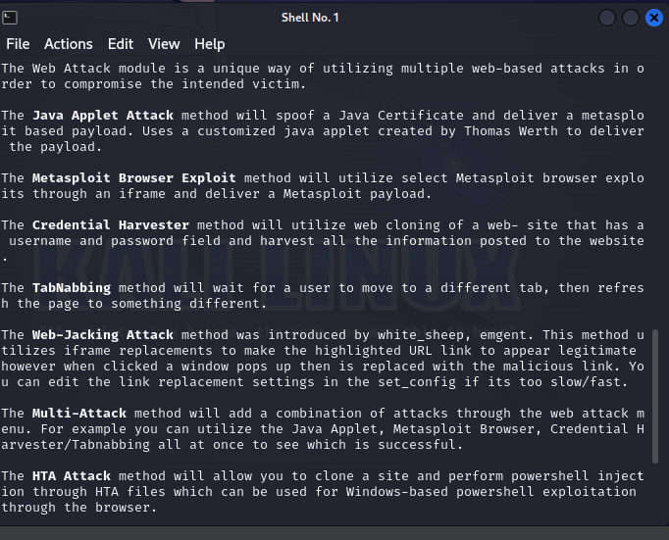
Steps for anaylsis for web attacks

Slide 11
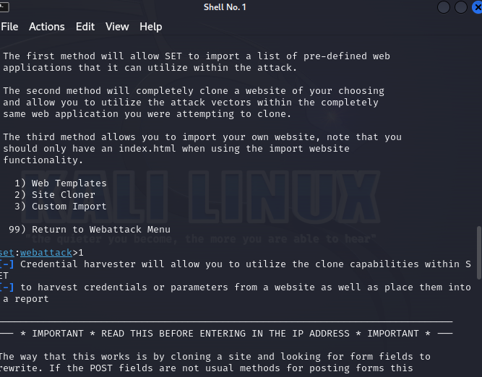
Clone web attacks for fake phshing attacks google sign in

